Slide 1




Babafemi Olayinka Data Analytics Portfolio
C BY-SA

Slide 2
- GameCo
1
Analysing global sales for a games company

Slide 3
Project overview
Objective: A global video game company, GameCo, is looking to use data to inform development of new games. As a data analyst, I will be performing descriptive analyses of video game data to better understand how GameCo’s new games might fare in the market
Data : Open-source data was obtained from VGChartz.
The dataset tracks the number of units sold (in millions) between 1980 and 2016.
Tools & Skills : Excel was used for all data cleaning, integrity, profiling, and consistency checks.
Excel was also used for pivot tables, descriptive analysis, and visualisations. Storytelling was achieved through PowerPoint.
Constraints : The dataset only covers the time period up to the end of 2016.
The dataset only tracks units sold, not total profit. Some games might have fewer sales but be at a higher price point thereby increasing their profitability. Digital sales were also not included in the dataset.

Slide 4
Cleaning and basic analysis
Row Labels | Sum of NA_Sales | Sum of EU_Sales | Sum of JP_Sales | Sum of Other_Sales
Action | 877.83 | 525 | 159.95 | 192.79
Adventure | 105.77 | 64.1 | 51.55 | 19.22
Fighting | 223.59 | 101.32 | 87.35 | 37.88
Misc | 410.24 | 215.98 | 107.76 | 79.51
Platform | 447.05 | 201.63 | 130.77 | 52.07
Puzzle | 123.78 | 50.78 | 57.31 | 13.72
Racing | 359.42 | 238.39 | 56.69 | 77.82
Role-Playing | 327.28 | 188.06 | 352.31 | 63.22
Shooter | 582.6 | 313.27 | 38.28 | 103.09
Simulation | 183.31 | 113.38 | 63.7 | 33.65
Sports | 683.35 | 376.85 | 135.37 | 136.73
Strategy | 68.7 | 45.34 | 49.46 | 12.14
Grand Total | 4392.92 | 2434.1 | 1290.5 | 821.84
Data has been collected between 1980 and 2016.
Initial analysis shows that action and sports are in the top three genres in all three regions, so those should be a focus for any new games.
Shooter is also popular in Europe and North America, and role-playing is popular in Japan.

Slide 5
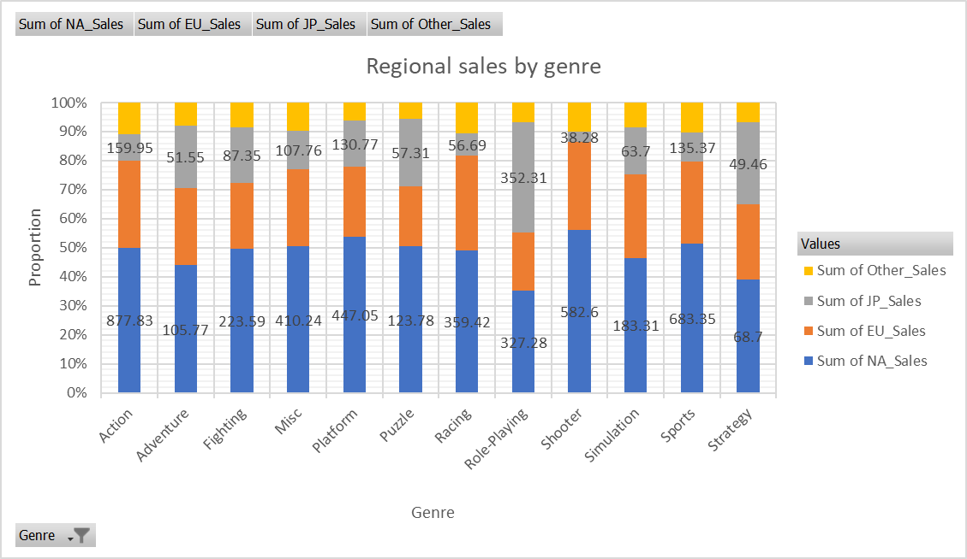
Analysis
Not until 2015 that NA sales sharply fall dip but was able to recover back in year 2017 where it sales grew back and Eu also falls dip till 2017 and was not able to recover back till now. But another surprise was JP sales grew so well from 2014 - 2017 and accounted for 100% proportion of the games sold in that year.
For me, GameCo should do more marketing support JP because our expectations was that EU was going to be doing better than JP all through but it turns out that, overall JP looks to do slightly better than EU not until recent times that EU was performing than JP. My expectation that NA will be doing the highest was confirmed by the analysis i did and we can see that NA is still the only region increasing in sales as at 2020 when the rest are in zero.

Slide 6

Recommendations
Final Project Report
For me, GameCo should do more marketing support JP because our expectations was that EU was going to be doing better than JP all through but it turns out that, overrall JP looks to do slightly better than EU not until recent times that EU was performing than JP. My expectation that NA will be doing the highest was confirmed by the analysis i did and we can see that NA is still the only region increasing in sales as at 2020 when the rest are in zero.
I will suggest that the GameCo Executive should revise their assumptions based on the analyzed data and appropriate their marketing budget for 2017 accordingly.
More data should be collected and analyzed to know why there is a drop in the NA & EU, is it a marketing issue or a natural occurrence. I can also recommend they support the growth in JP and do more marketing to retain it, as the analysis as shown that JP sales might account for the 100% global sales in the coming year

Slide 7
Influenza Season
2
Medical staffing across the US during influenza season

Slide 8
Objectives : To help medical staffing agencies provide temporary workers to hospitals and clinics across the US on an as needed basis, by identifying geographic and seasonal trends for annual influenza outbreaks.
Data : Four datasets were used in this project, all of which are made available by various branches of the US government including, influenza deaths rates, influenza lab testing, and influenza shot rates in children by the CDC, and population data from the US Census Bureau.
Tools & Skills : A data research project was designed and excel was used for all data cleaning, profiling, wrangling, integration, and transformation. Excel was also used for statistical analysis including correlation and hypothesis testing. Visualisations and storytelling were achieved through Tableau.
Constraints : The datasets only cover 2009 – 2017. Naturally, because it is medical data, patient information has been suppressed (e.g., children under a certain age or patients with underlying medical conditions). A lot of the data is based on estimates, and there are some time lags particularly when handling the census data.
Links : https://public.tableau.com/app/profile/babafemi.olawale.olayinka/viz/PreparationforInfluenzaSeason2_0/Story1?publish=yes
https://youtu.be/a5ZYQMC8Dhw

Slide 9
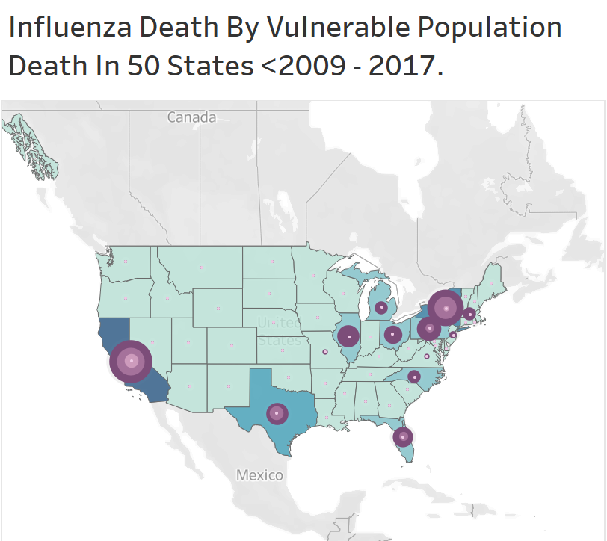
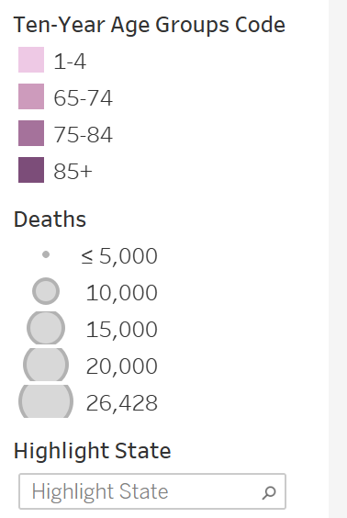
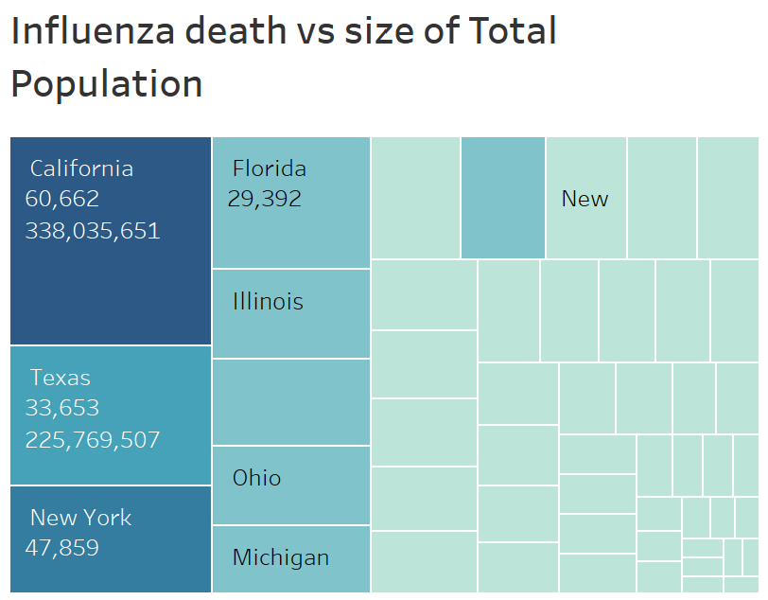
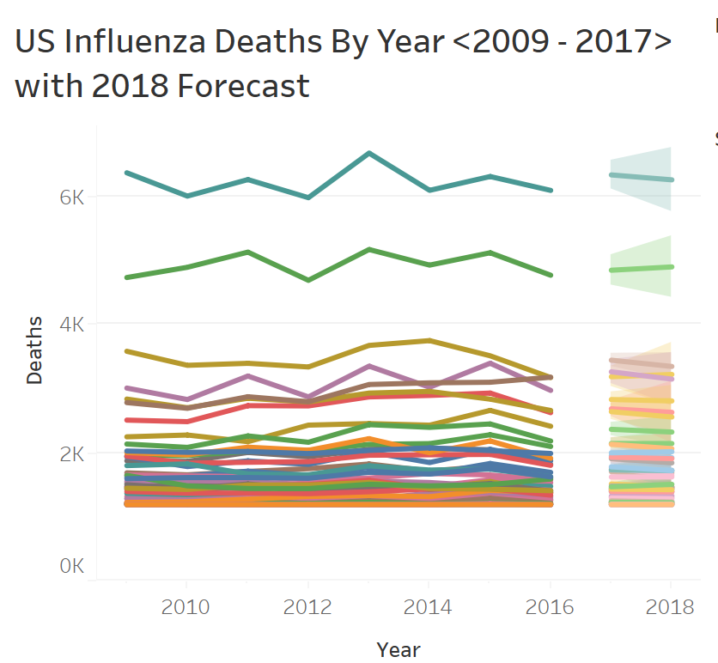
The forecast also shows relatively moderate to high forecast for the year 2018 across each state. The chart below reinforces the hypothesis that if additional staff are provided to clinics located with city with highly vulnerable population during the flu season, there will be reduction in the number of deaths among vulnerable population during flu season. Therefore, a need for additional medical staff.
It clearly seen that the states with the high total population and highly vulnerable population have the largest Influenza death record, therefore additional medical staff to states with high number of population and highly vulnerable population will help reduce the number of Influenza death in those states. The top five most impacted states are California, New York, Texas, Pennsylvania, and Florida.

Slide 10
Recommendations
Final Project Report in Tableau
Influenza is seasonal, peaking between November and March, so staff should be in place before October in order to prepare appropriately for demand
As seen from the various visuals, the states with larger population and higher percentage of vulnerable population are at risk of high rate of hospitalization and death during INFLUENZA season. I believe that additional medical staff should be planned and sent accordingly to the size of each state population and percentage death of her vulnerable population.
Additional medical staff should be plan according to the expected staff to patient ratio during INFLUENZA season as laid down by CDC.
Additional research is needed. Where states have higher proportions of influenza deaths compared to their population it's worthwhile investigating why, to understand whether the underlying reasons warrant additional support during influenza season.
Links : https://public.tableau.com/app/profile/babafemi.olawale.olayinka/viz/PreparationforInfluenzaSeason2_0/Story1?publish=yes
https://youtu.be/a5ZYQMC8Dhw

Slide 11
Rockbuster Stealth
3
Analysis of fictitious DVD rental company

Slide 12
Project overview
Objectives : Rockbuster is a fictitious DVD rental company looking to break into the online video rental market due to competition from streaming services such as Netflix and Amazon Prime. For that purpose, they want to gain insights of their current portfolio performance and customer base to be able to make an informed decision towards the best strategy that can help them say competitive.
Data : The dataset was provided by CareerFoundry and contains information about Rockbuster’s inventory, locations, customers, and employees. It can be found here. For the purposes of this project, I created a Data dictionary.
Tools & Skills : I was predominantly working on relational databases using PostgreSQL. I also used DBVisualiser to create an entity relationship diagram which can be found in the data dictionary linked above. Data was exported to excel and visualisations were created using Tableau, with the final presentation being in PowerPoint.
Constraints : This was a dummy dataset created by CareerFoundry for the purpose of this project, therefore limited real-world insights could be gained.

Slide 13
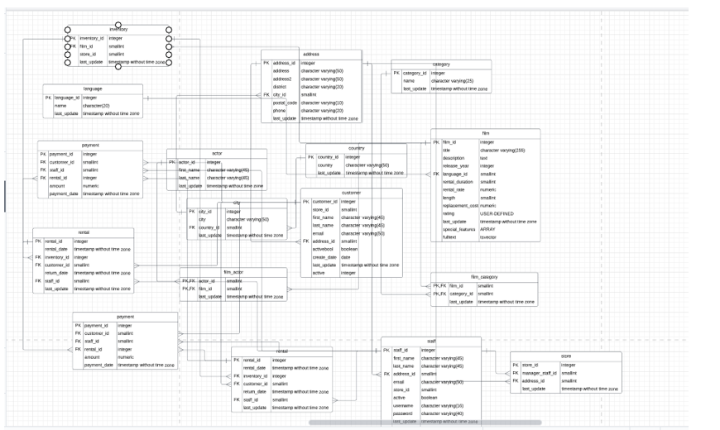
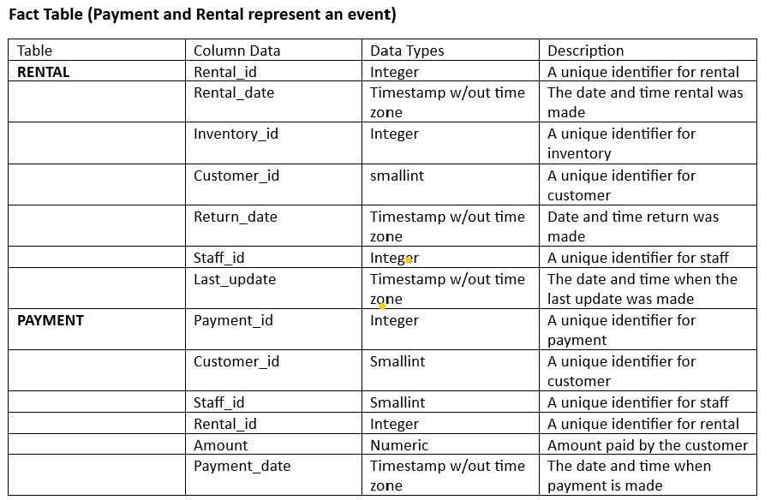
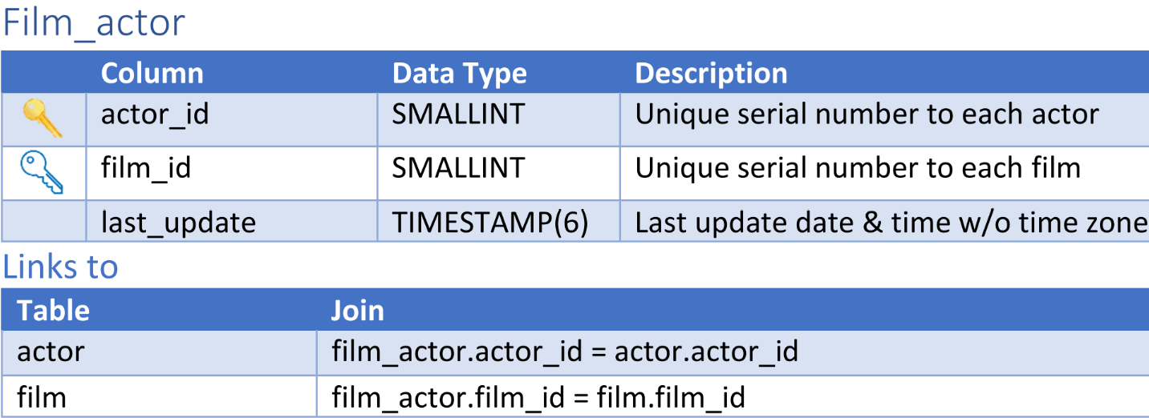
Database Management
Rockbuster Stealth has 15 relational databases covering things such as payment, location, and customer information, and information related to the films including inventory, language, category, and rating.
A data dictionary was created for this project

Slide 14
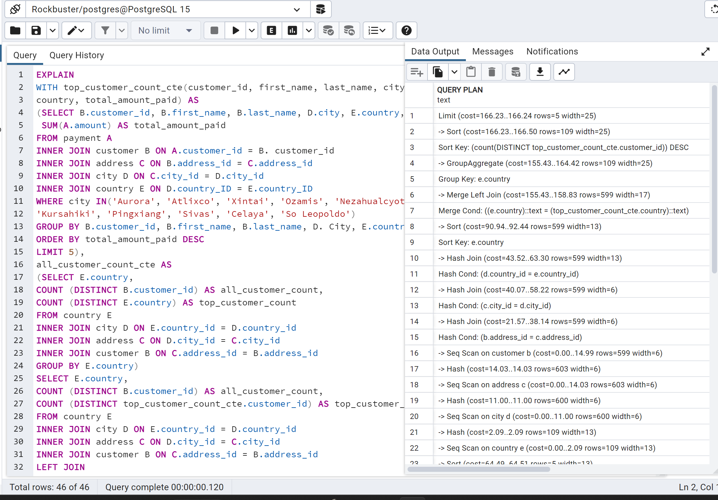
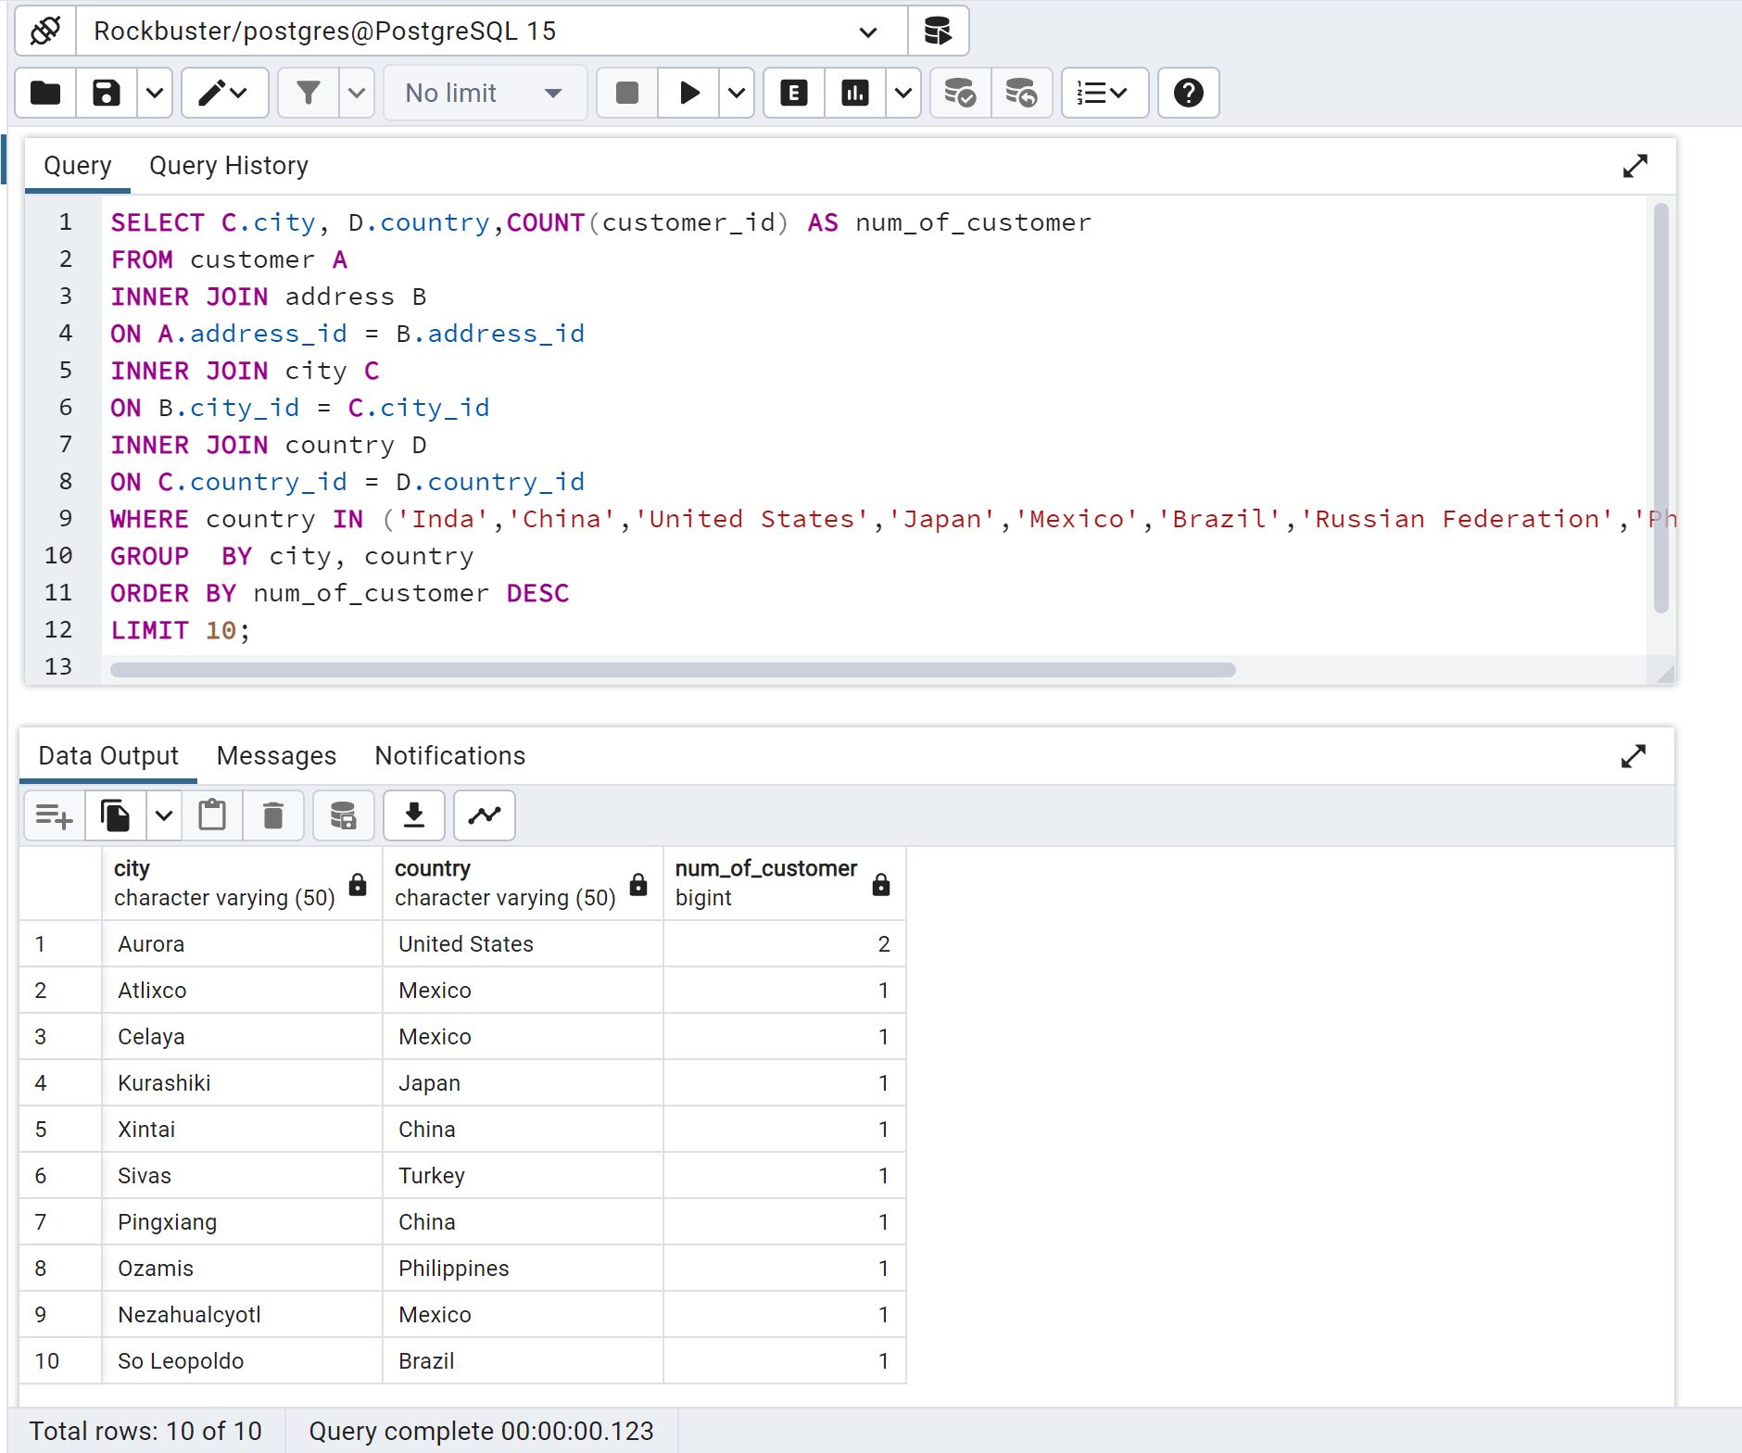
Cleaning and analysis revealed some key initial insights, including about Rockbuster’s global presence: Active in 109 countries 599 customers 1000 movies $61,312.04 total revenue 14,596 rentals
Cleaning and initial insights

Slide 15
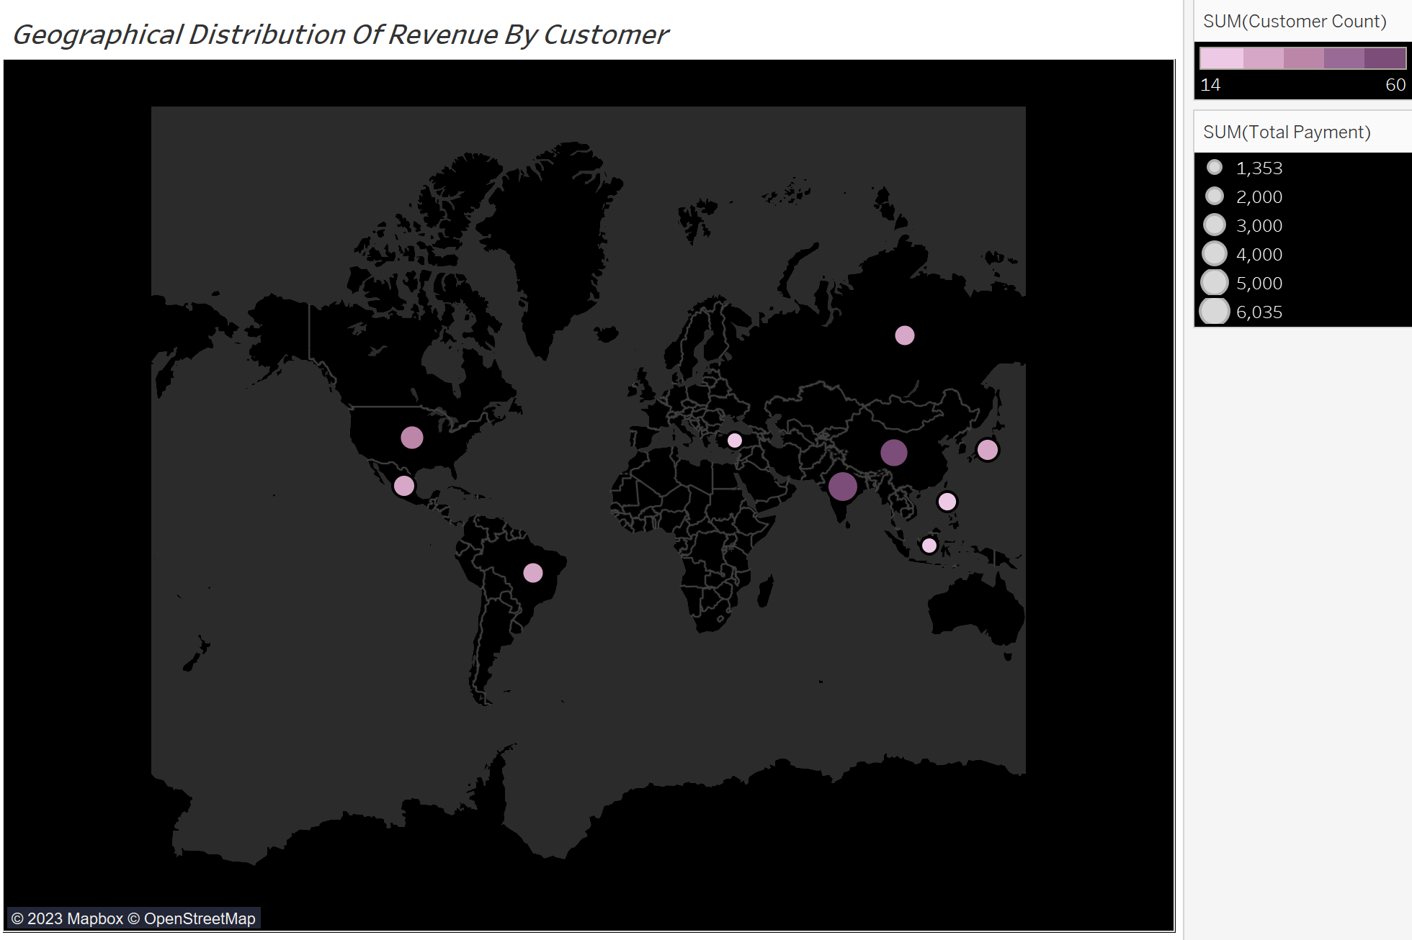
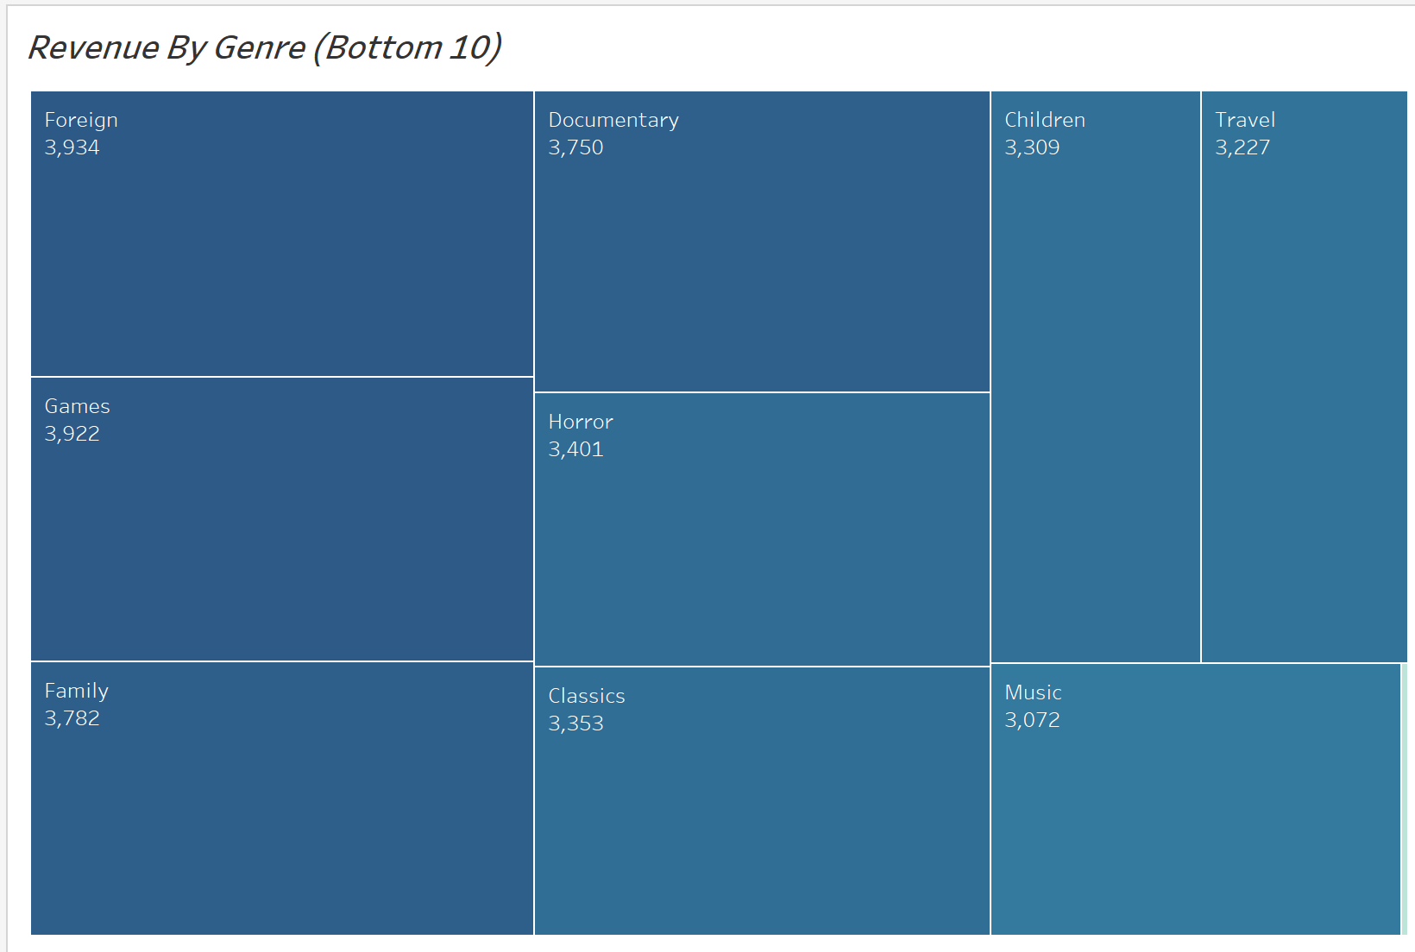
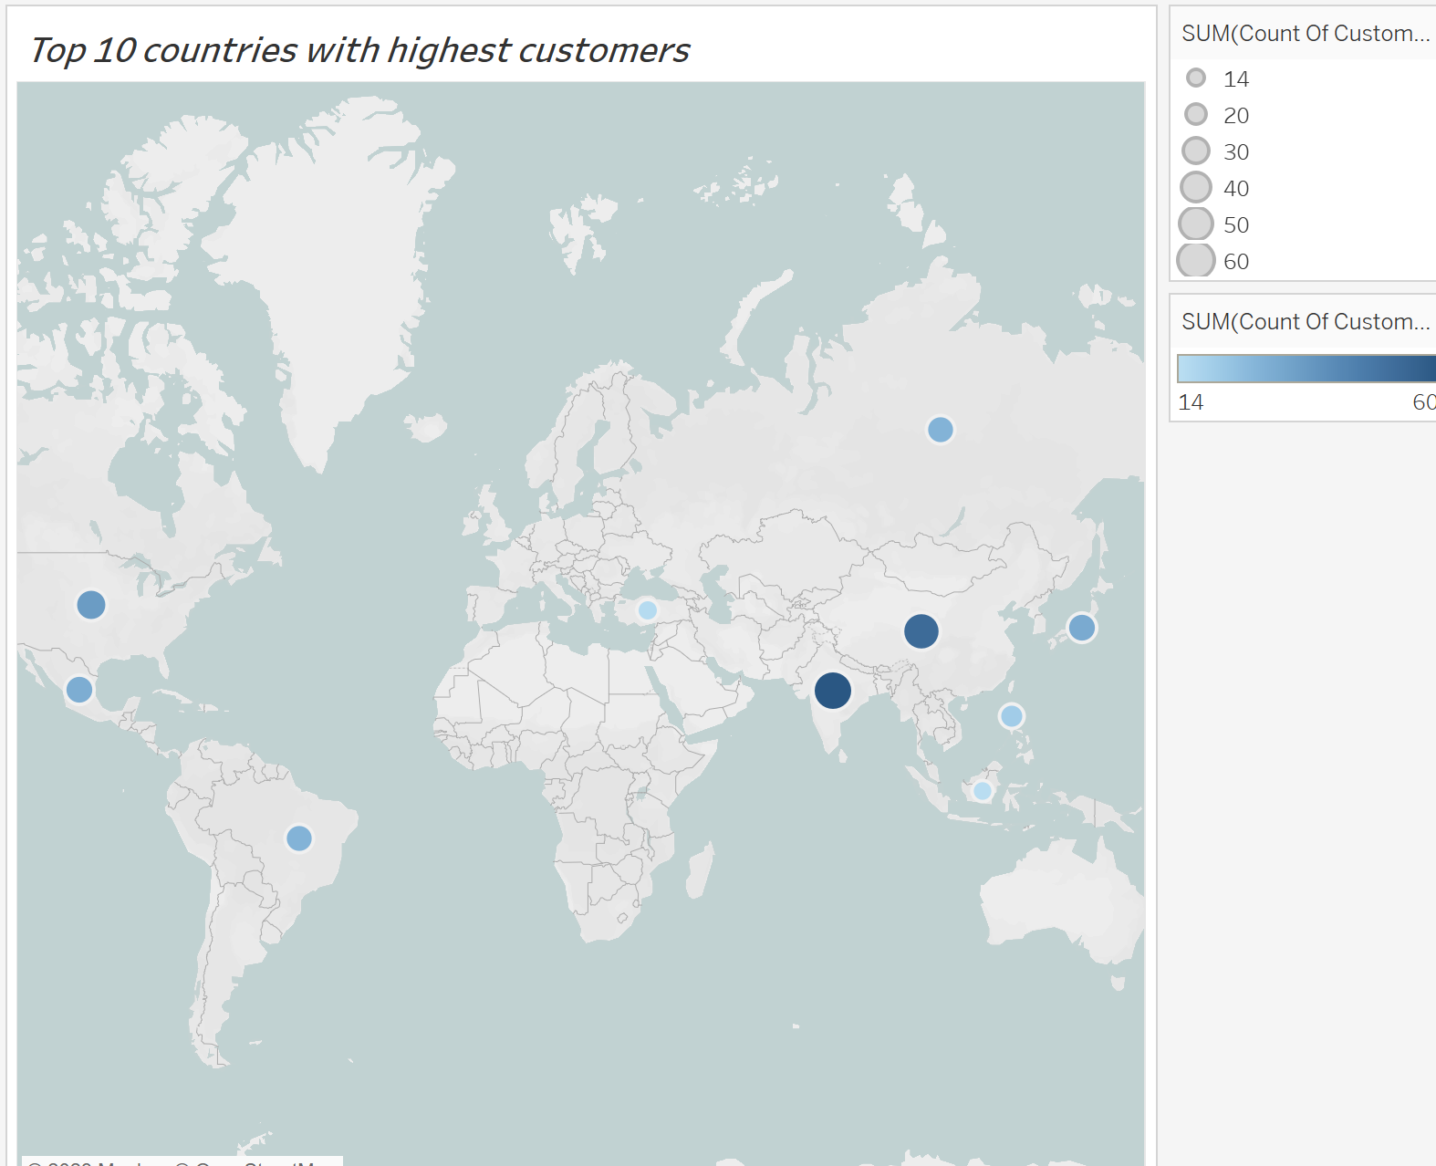
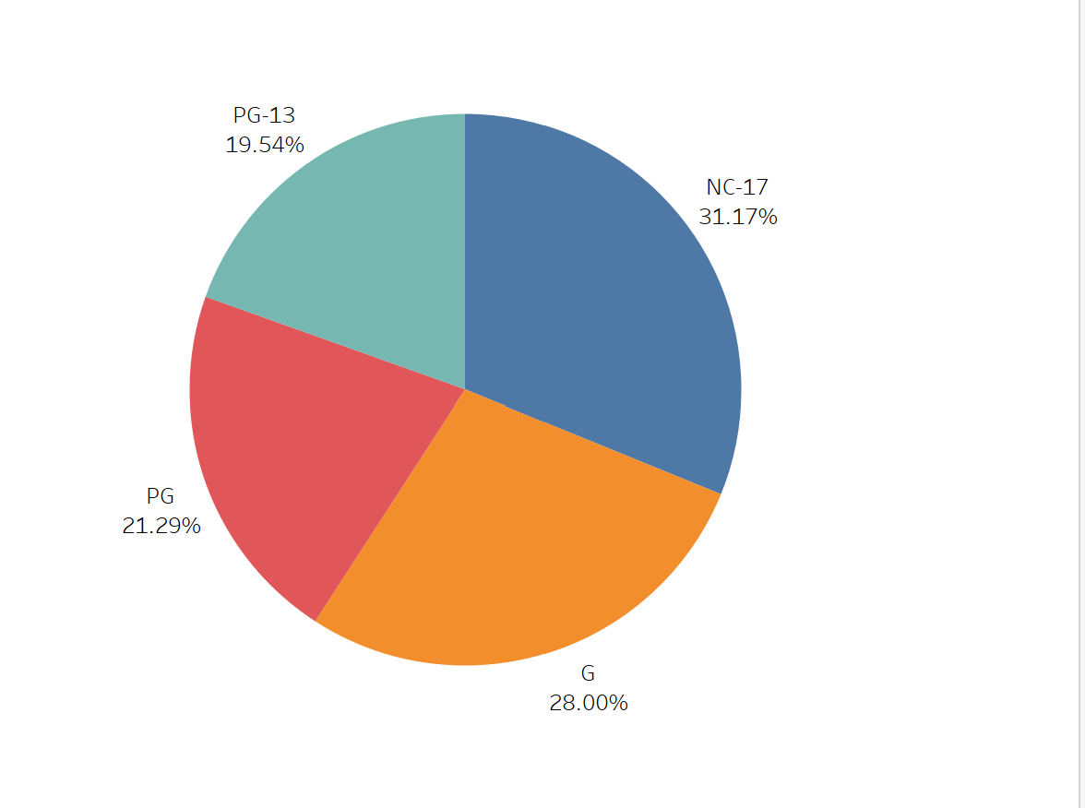
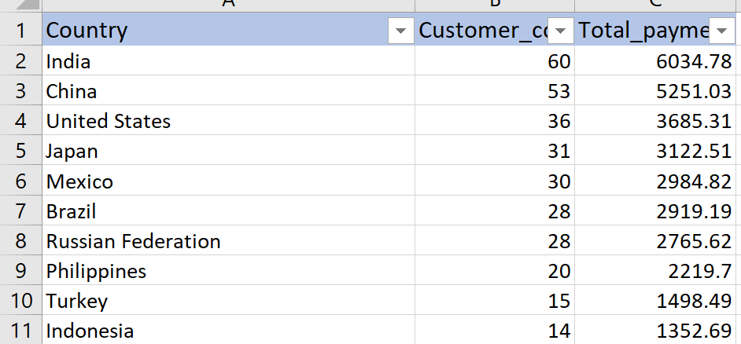
Different Visuals showing the distribution of revenue by customer location, by Genre and by Rating

Slide 16


Recommendation
I suggest we stock more films with Genre that provides more revenue than that which have the highest rental duration.
I suggest further research into why our movies are not generating enough revenue in those Bottom 10 Countries.
Draw a feasibility plan to grow revenue in Europe, Australia and North America, maybe a rewards system for frequent renters or streamers and increase stocks across all ratings.
Babafemi
Babafemi.olayinka@gmail.com

Slide 17
Instacart Basket
4
Analysing sales data for successful US-based online grocery company

Slide 18
Project overview
Objective : To conduct exploratory analysis for Instacart Grocery, a US-based online grocery store. To derive insights into customer sales patterns, segment customers based on behavioural and demographic profiles to analyse spends, and then make recommendations for targeted marketing campaigns.
Data : Opensource purchasing data was supplied by Instacart and can be found here. Customer data was fabricated by CareerFoundry for the purposes of this exercise and be found here.
Tools & Skills : Analysis was conducted in Python using Jupyter notebooks. Many libraries were used including pandas, numpy, matplotlib, scipy, and seaborn.
Analysis involved:
Data cleaning including data wrangling and consistency checks.
Data manipulation including merging datasets, deriving new variables, and subsetting.
Data analysis including aggregating data, creating visualisations, using crosstabs, and descriptive statistics.
Constraints : Data supplied by Instacart is only from 2017 and some data had to be fabricated for the purposes of the project. A randomised 70% subset had to be used due to memory issues.

Slide 19
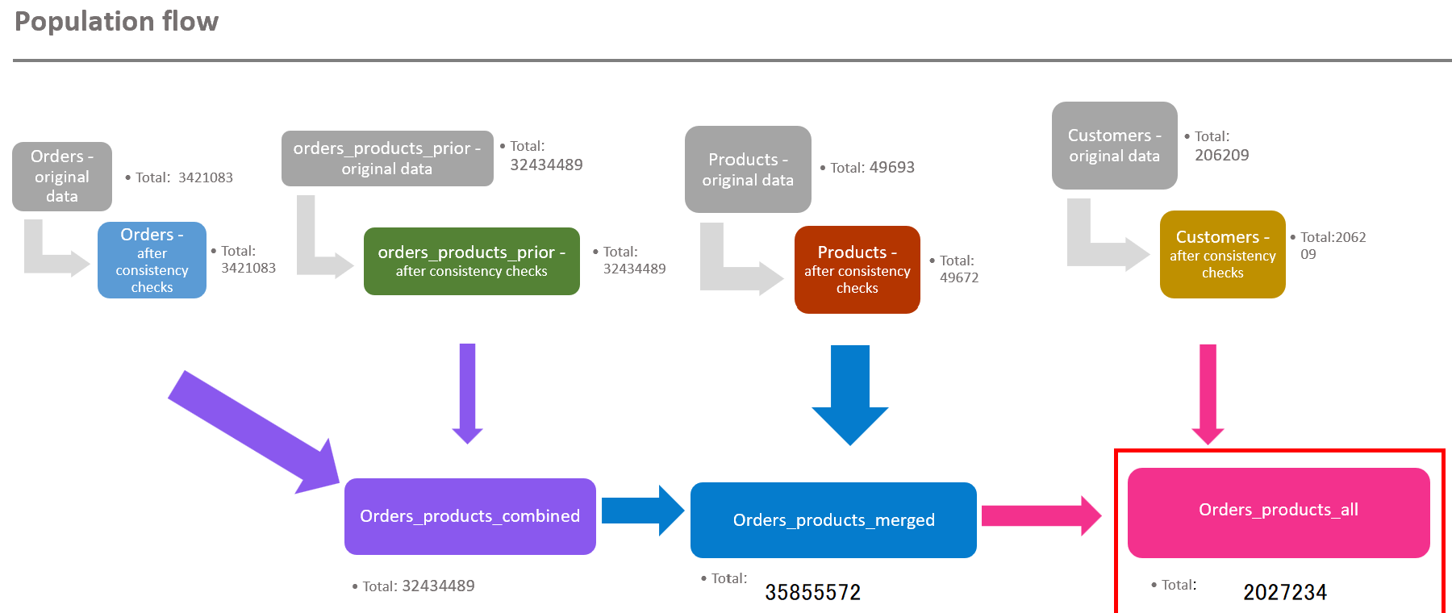
Key insights: data cleaning & wrangling
Four datasets were cleaned, wrangled, and merged to create the final set we used for our analysis. The data contained over 21 million rows.
Dataframe | Columns dropped | Columns renamed | Columns' type changed | Comment/Reason
Orders |  |  | order_id has been changed to 'str' | eval_set has no meaning to the data to be analyzed, it redundant. I changed the data type because I want to run the descriptive statistics of relevant column alone
 |  |  | The data type of the "user_id" column has been changed from number to string. | This will make describe() function ignore string values when calculating descriptive statistics
 | eval_set |  |  | The data didn't have an impact on analysis
 |  |  | order_number' ('int64') to ('int8')
 | unnamed column 0 was dropped |  | orders_day_of_week' ('int64') to ('int8')
 |  |  | order_time_of_day' ('int64') to ('int8')
 |  |  | days_since_prior_order' from ('float64') to ('float16')
 |  | column days_since_prior_order was changed to number_of_days_between_orders |  | To make the column name more succinct
Departments |  |  |  | Transposed to create a department dictionary
Products |  |  | aisle_id' from ('int64') to ('int8') | To save memory and merge faster
 |  |  | department_id' from ('int64') to ('int8') | To save memory and merge faster
 |  |  | prices' from ('float64') to ('float16') | To save memory and merge faster
 |  |  | product_id' from ('float64') to ('float16') | To save memory and merge faster
 |  |  | add_to_cart_order' from ('float64') to ('float16') | To save memory and merge faster
 |  |  | reordered' from ('float64') to ('float16') | To save memory and merge faster
Customers |  |  | age' from ('int64') to ('int8')
 |  |  | no_of_dependents' from ('int64') to ('int8')
 |  |  | income' from ('int64') to ('int32')
 |  | STATE' has been changed to: 'State' |  | To keep name consistent with other column titles' format
 | First Name' has been dropped |  |  | To keep name consistent with other column titles' format
 | Surnam' has been dropped |  |  | To keep name clear and consistent with other column titles
 |  |  |  | To keep name consistent with other column titles' format
 |  | n_dependents as No_of_Dependents |  | To keep name clear and consistent with other column titles
 |  | fam_status as Family_Status |  | To keep name consistent with other column titles' format
 |  |  |  | How to address: Dropping these two columns in compliance to customer privacy
 |  |  |  | To keep name clear and consistent with other column titles

Slide 20
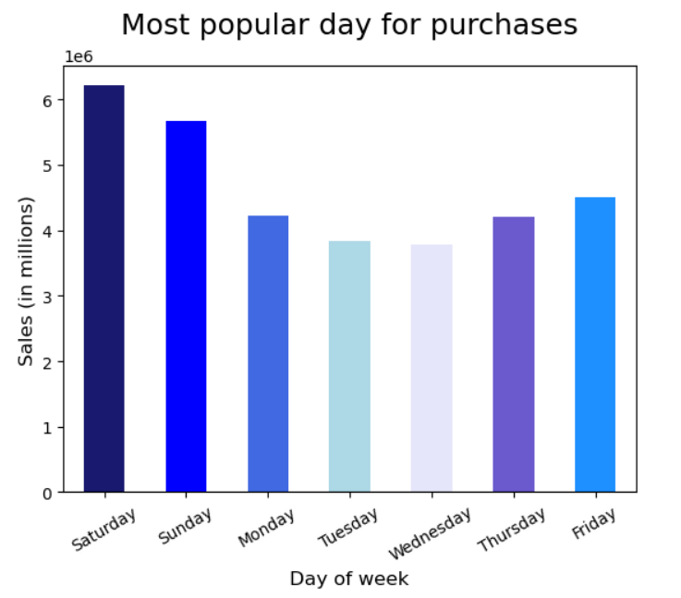
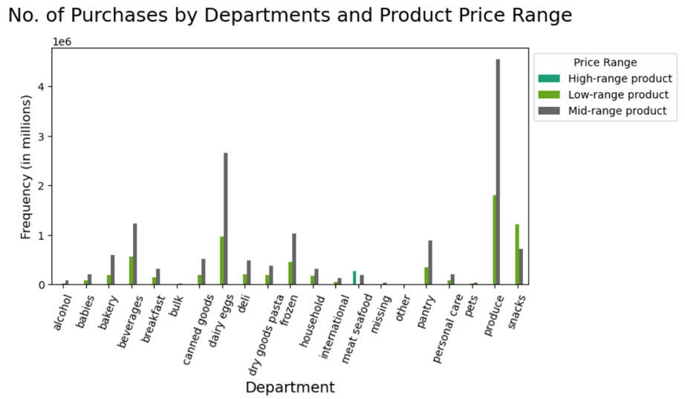
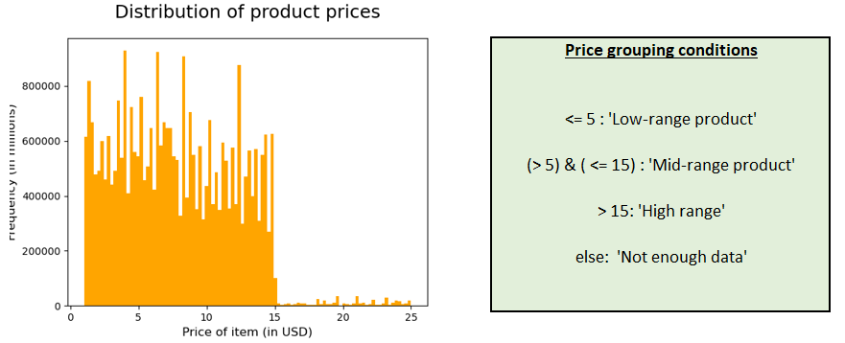
Initial analysis
The most popular days of the week for purchasing are Saturday and Sunday. The most popular hours are within a standard hours, 9am until 5pm.
The most popular departments are produce and dairy/eggs.
Most products fall within mid or low-range price groups.

Slide 21
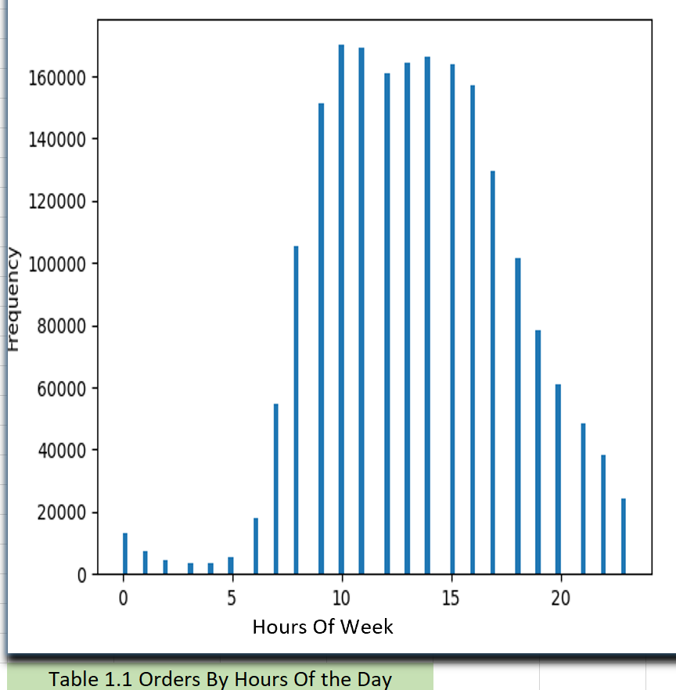
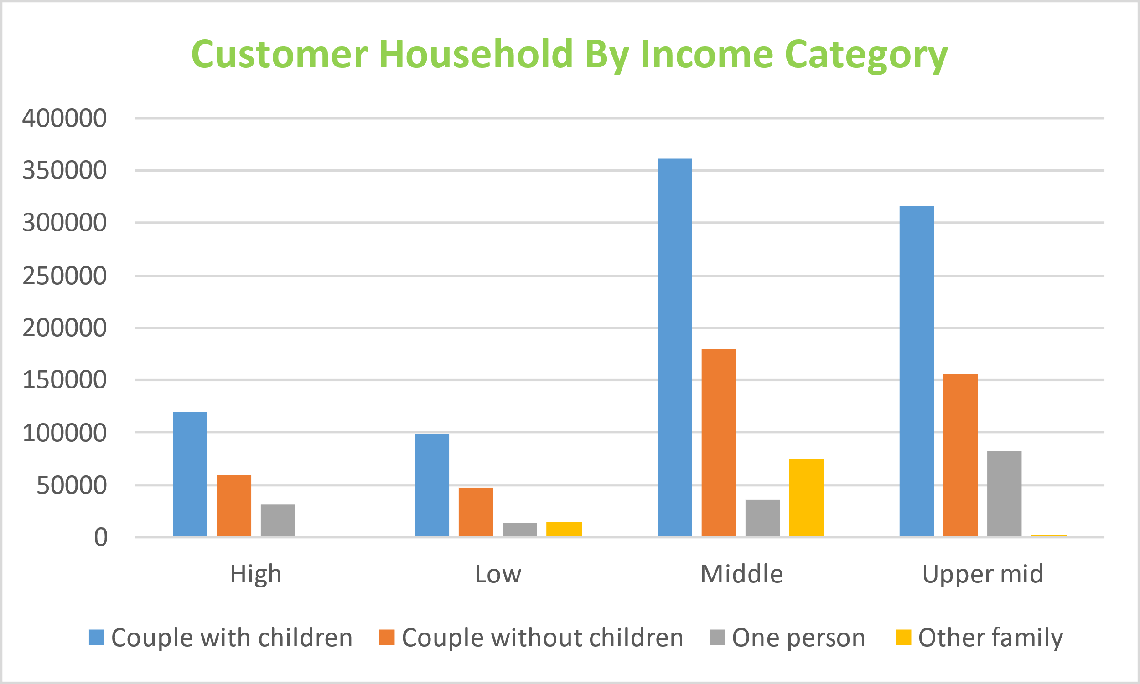
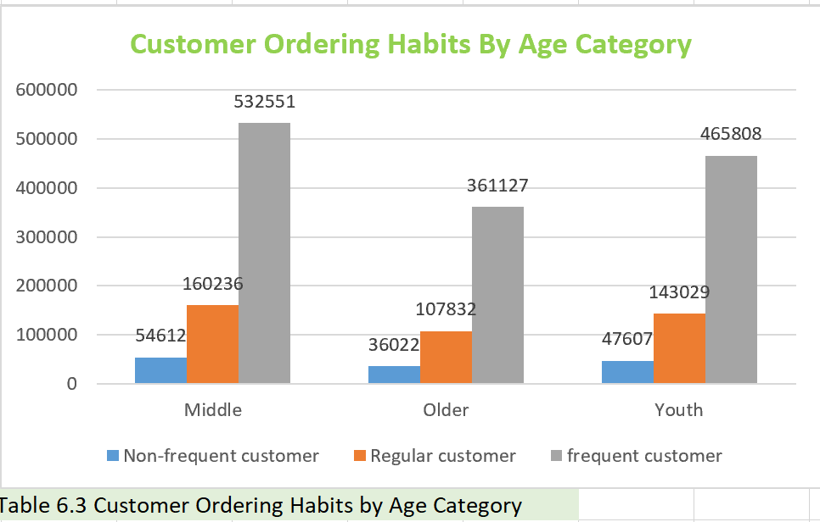
Customer profiling
Within all types of Income categories, frequent customer order the most, followed by regular customer and then the non-frequent customers. Meaning, irrespective of the Income level of our customers, the frequent customers are always ordering the most. The middle Age group order the most in all regions among all types of customer. The older Age group make the less orders across all type of customers. The busiest days of the week Saturday, Sunday and Friday respectively .The busiest hour of the day is between 10am to 5pm which signifies the most time orders are been placed.

Slide 22
Recommendations
Final Project Report in Excel
High frequency of orders with a low expenditure are placed during the day (9am-5pm). However, a low frequency of orders with a high expenditure happens between 6-8am, early in the morning. Instacart can apply some discounts/promotions if ordered are placed during some hours/days, mostly during the busy hours/days on more all products types including the products that are expensive so as to bring traffic of customers that do not consider buying high price products.
51% of orders have been placed by regular customers, 33% by loyal customers, and the remaining 16% are submitted by new customers. Ordering habits in different regions are almost the same from proportional perspective. We can introduce some discount like 15-20% off for next order in 5 days to motivate customers return more and turn them to the loyal customers.
Access to time-series data would allow us to look at seasonal and annual trends and could reveal further insights.
Ads should be targeted at customer with 'single' household status and customers with a 'non-frequent' loyalty status. The two categories of customers seems to be making the least orders when we compare ordering habits across customer profiles across all regions. Most of the ads should focus on when those category of customers make their orders, whether it peak or non-peak periods.

Slide 23
Thanks!
Any questions ?
You can find me at
Babafemi.olayinka@gmail.com
https://github.com/Babafemi01
Tableau
LinkedIn

